Slide 1
Weekly Presentation
Jiayu Chen
2023.8.21
Notes:
Ok, I will begin my weekly Presentation

Slide 2
Work Description
Work_1: Attempting to predict S and D using signals with a noise level of 0.8 by decomposition. The achieved MAE for S is 3.9, and for D is 5.8, compared to last week's values of S=13 and D=9.
Work_2: Attempting to predict S and D using signals with a noise level of 0.1 by getting template. Some interesting observations were made.
Work_3:Tutorial Writing
Work_4:Theoretical knowledge Learning

Slide 3
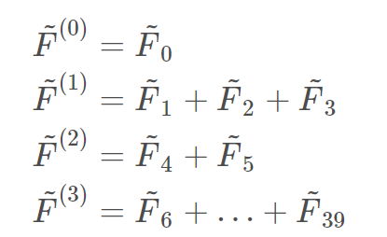
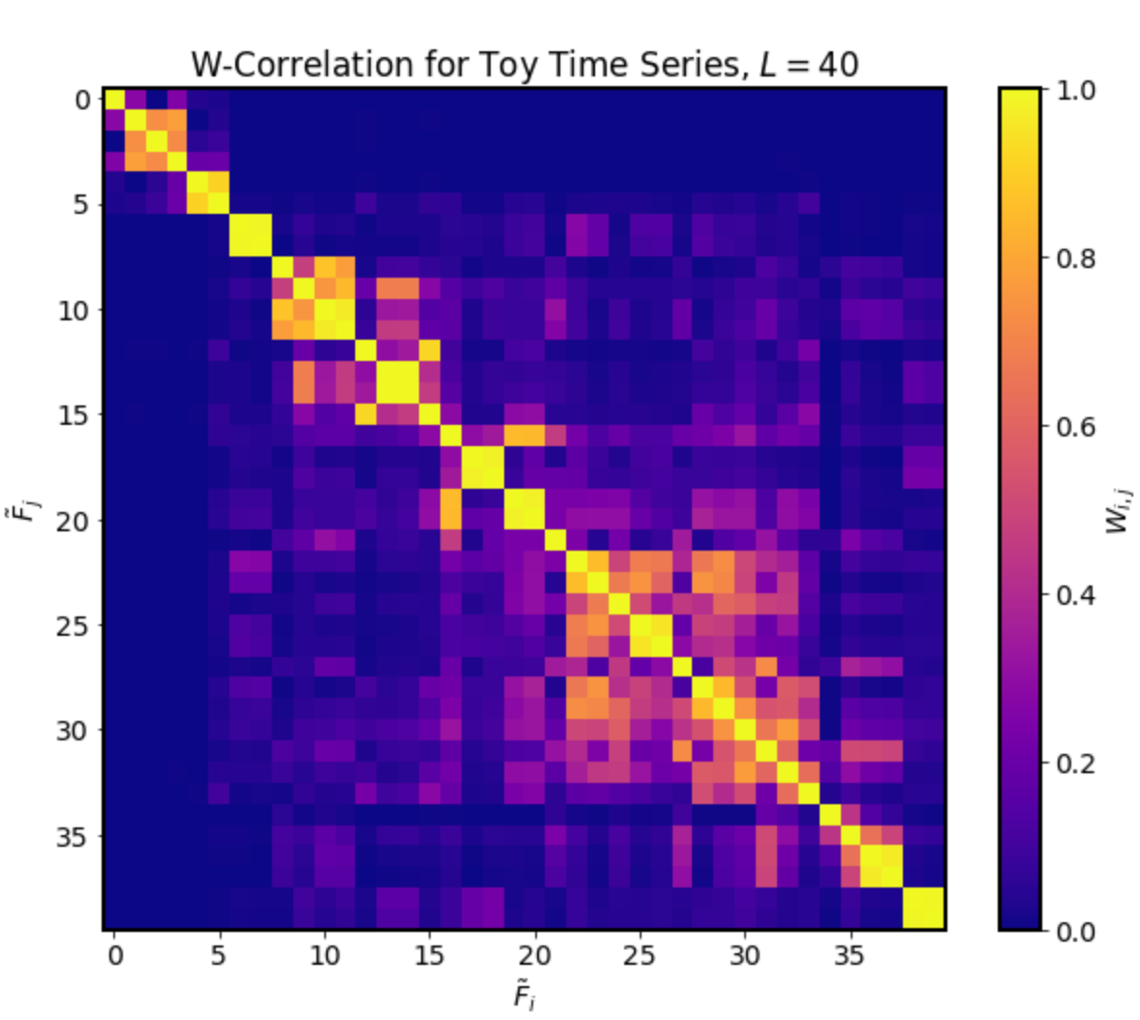
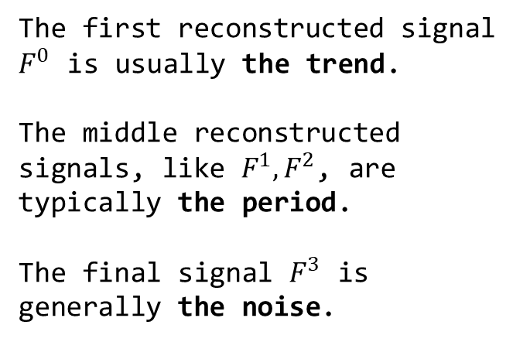
Work_1: S & D prediction in the noise level of 0.8
Process of Singular
Spectrum Analysis (SSA)
Step2.
Time Series Component Separation and Grouping
Components of time series are grouped together through visual inspection.
Step1.
perform SVD on the processed signal, and compute the W-correlation coefficients
Step3.
Reconstruct signals based on the groups
The first reconstructed signal $F^{0}$ is usually the trend.
The middle reconstructed signals, like $F^{1}, F^{2}$, are typically the period.
The final signal $F^{3}$ is generally the noise.
Notes:
In this week's tutorial writing, I found that Singular Spectrum Analysis (SSA) works exceptionally well for denoising SCG signals in high-noise situations.
Let's take a look at Process of Singular Spectrum Analysis .
Step one is performing Singular Value Decomposition (SVD) on the processed signal, and computing the W-correlation coefficients.
In step two, Time Series Component Separation and Grouping, the components of the time series are grouped together through visual inspection. Which means， I just look at the picture of W-correlation and divide it into several groups together manually. In this matrix, we identified four such blocks, corresponding to the four green boxes.
Currently, it seems there isn't an automated method for the grouping.
Step three involves reconstructing signals based on these groups.
On the left are signal components within the four green boxes, reconstructed into four signals.
The first reconstructed signal, 𝐹^0, usually represents the trend.
The middle reconstructed signals, like 𝐹^1, 𝐹^2, typically represent periodic components.
The final signal, 𝐹^3, generally represents noise.

Slide 4
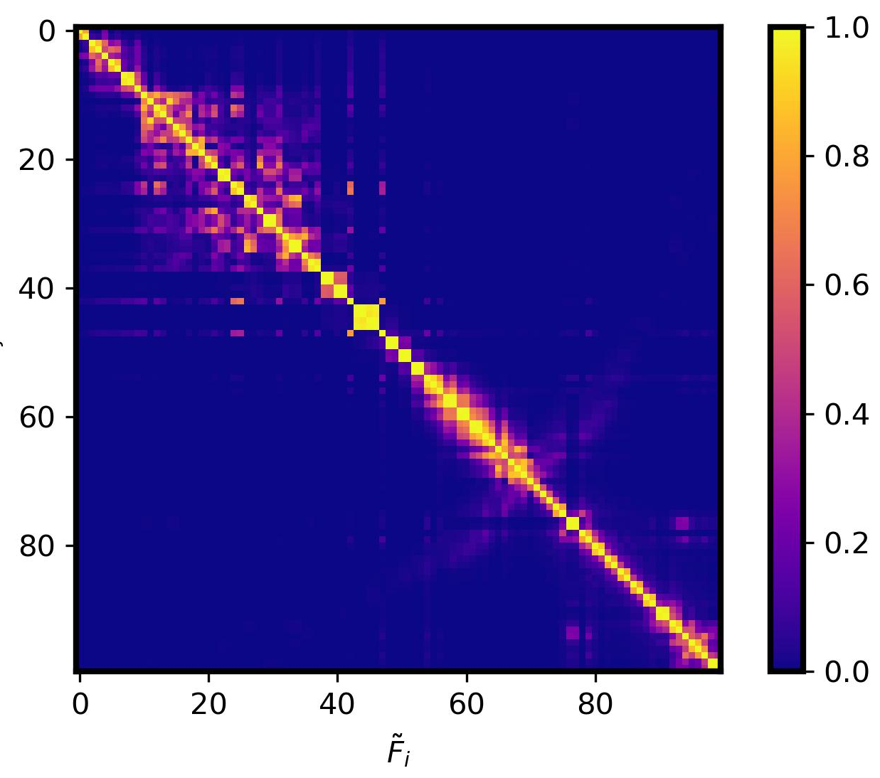
Work_1: S & D prediction in the noise level of 0.8
The process of simplified SSA I used
Step2.
Based on empirical values, components of time series are divided in two groups: Trend + (Period + Noise).
Step3.
Reconstruct signals based on the groups
Step1.
perform SVD on the processed signal, and compute the W-correlation coefficients
The first reconstructed signal is generally the trend.
The second reconstructed signal is a combination of the period and the noise.
Notes:
In practical scenarios, dealing with thousands of SCG signals makes it impossible to apply Step 2 of SSA, which involves visual inspection and subjective grouping. Thus, practical application becomes challenging.
In Step 2, I've made a change. Instead of dividing it into Trend + Period + Noise, I've divided it into two main groups: Trend + (Period + Noise). The points of division between these two components are determined based on empirical values.

Slide 5
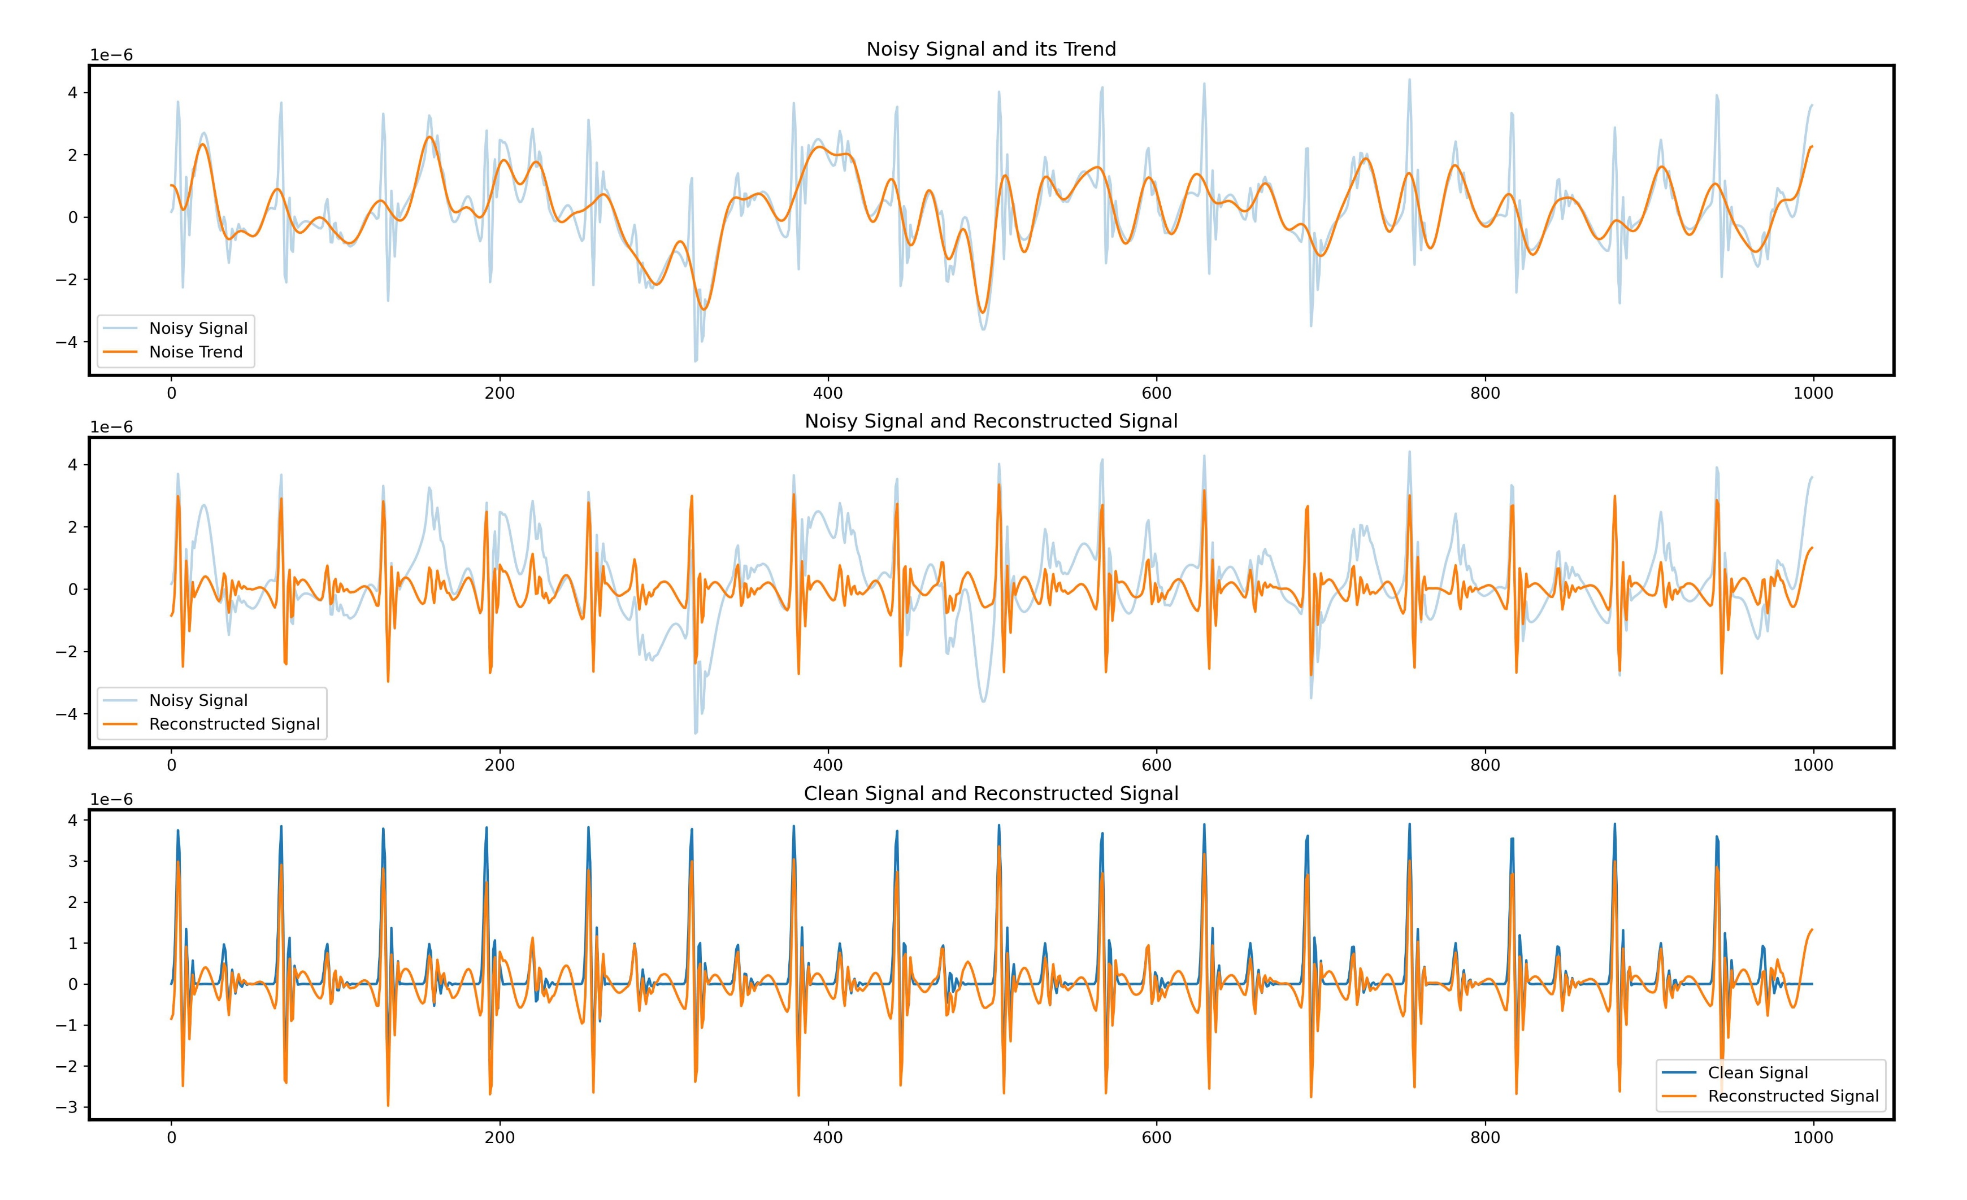
Work_1: S & D prediction in the noise level of 0.8
The effectiveness of denoising using SSA
Original SCG signal with a noise level of 0.8
Trend extracted using SSA
Original SCG signal with a noise level of 0.8
(Period + Noise) extracted using SSA
SCG signal with no noise
(Period + Noise) extracted using SSA
Notes:
This image is from my tutorial. In this image, the noise level in the SCG signal is 0.8.
In the first image, the blue line represents the original SCG signal with a noise level of 0.8. The yellow line represents the Trend component extracted using SSA.
In the second image, the yellow line represents the Period+Noise component extracted using SSA.
In the third image, the blue line represents a signal with no noise, while the yellow line represents the Period+Noise component extracted using SSA.
After applying SSA, the distinct peak features that were difficult to discern in the original signal with a noise level of 0.8 are accurately restored.

Slide 6
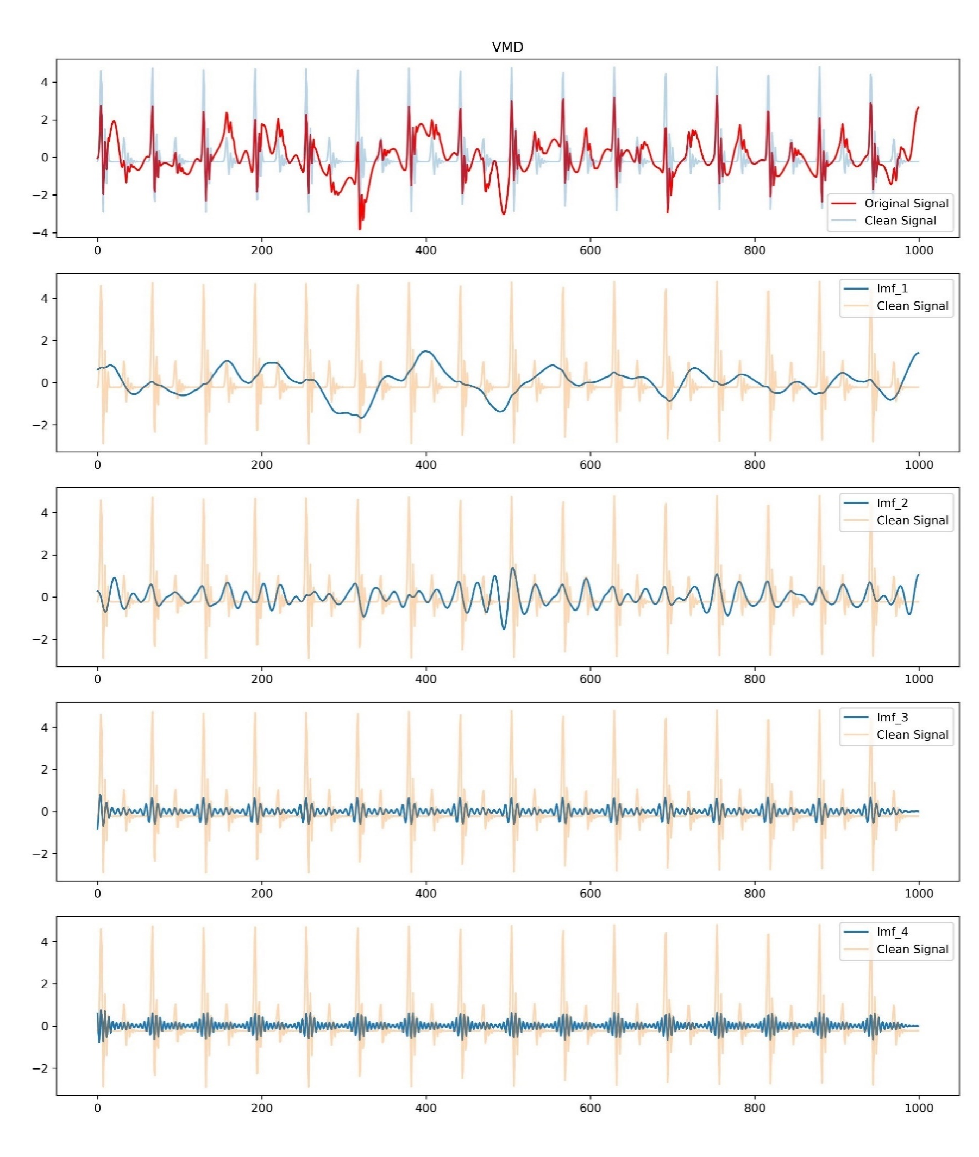
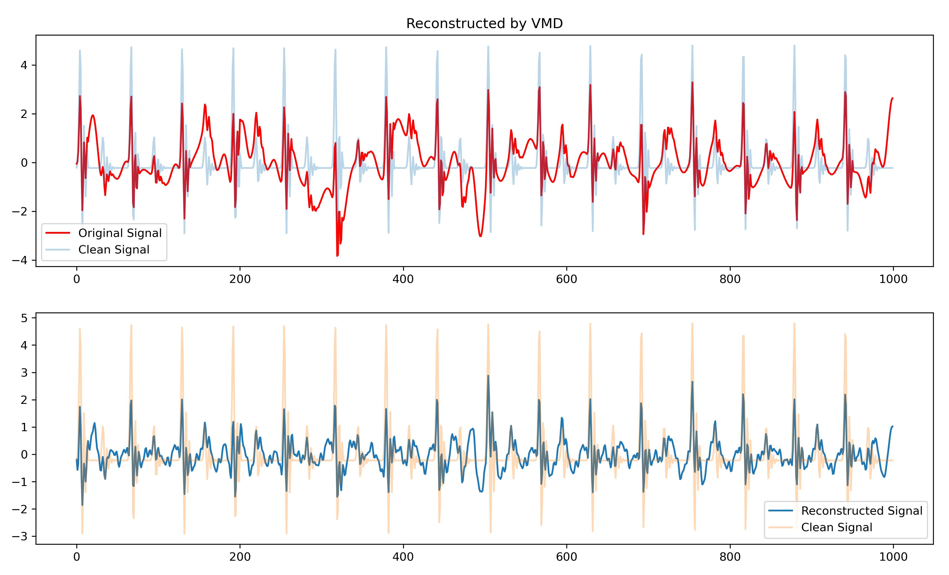
Work_1: S & D prediction in the noise level of 0.8
The decomposition effects of VMD
Reconstruction
Notes:
上周，song教授你提到了VMD等分解算法。
我使用你在Tutorial Outline里提到的四种分解算法挨个进行了尝试。
我分别对他们进行分解后重构，

Slide 7
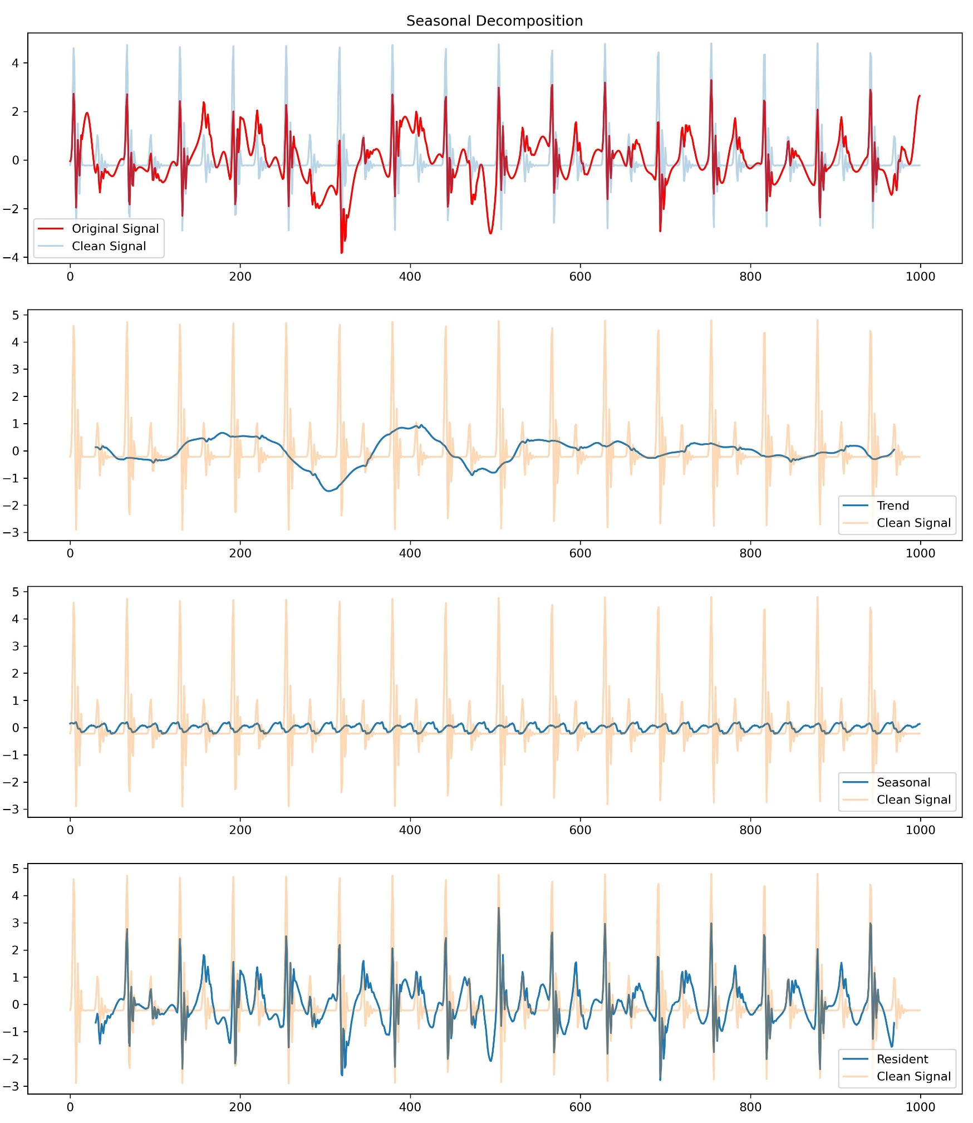
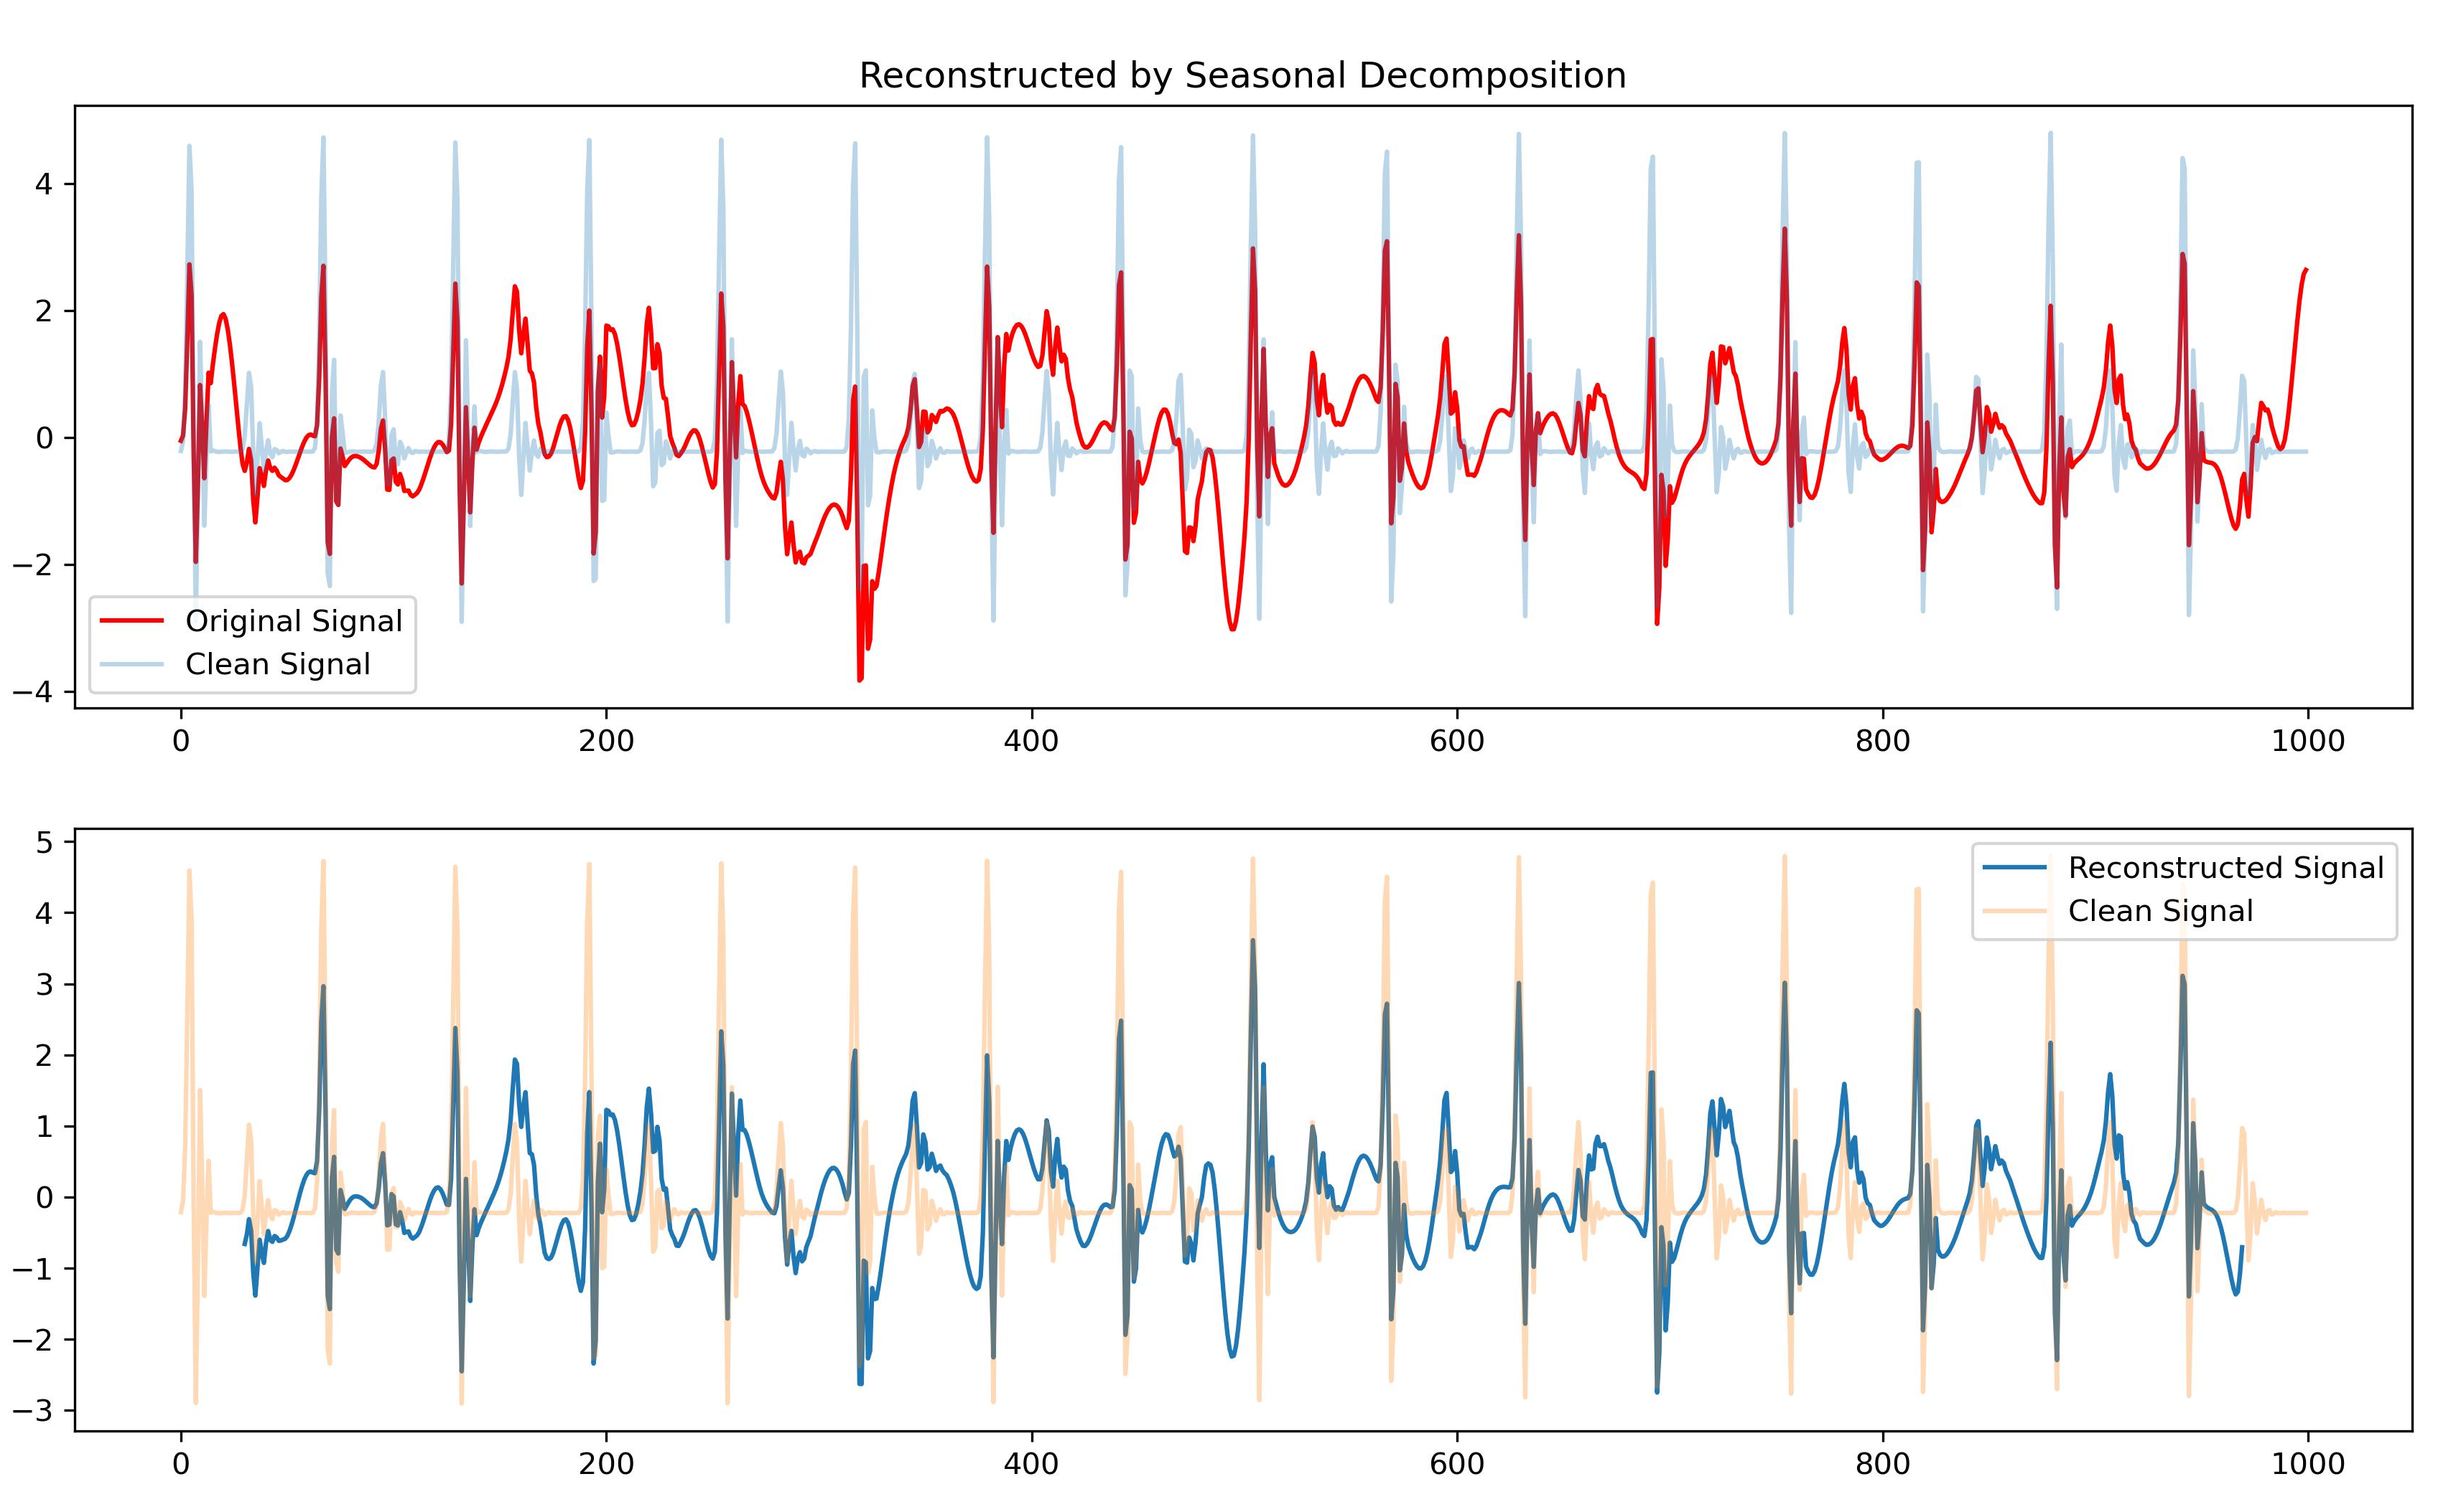
Work_1: S & D prediction in the noise level of 0.8
The decomposition effects of Seasonal Decomposition
Reconstruction
Notes:
上周，song教授你提到了VMD等分解算法。
我使用你在Tutorial Outline里提到的四种分解算法挨个进行了尝试。
我分别对他们进行分解后重构，

Slide 8
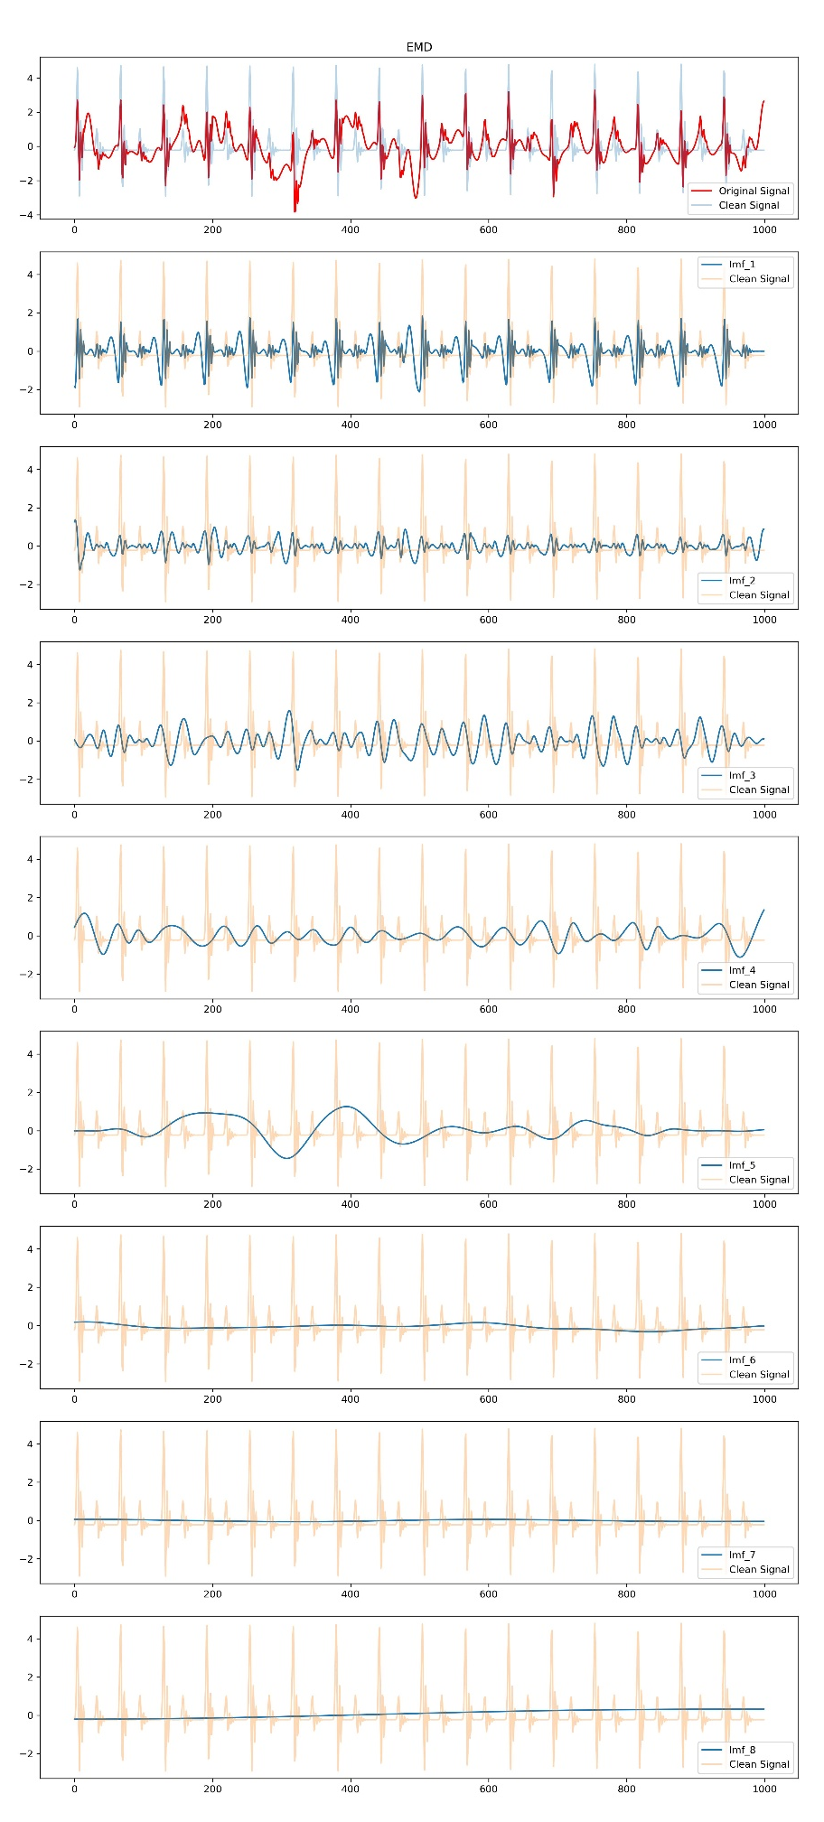
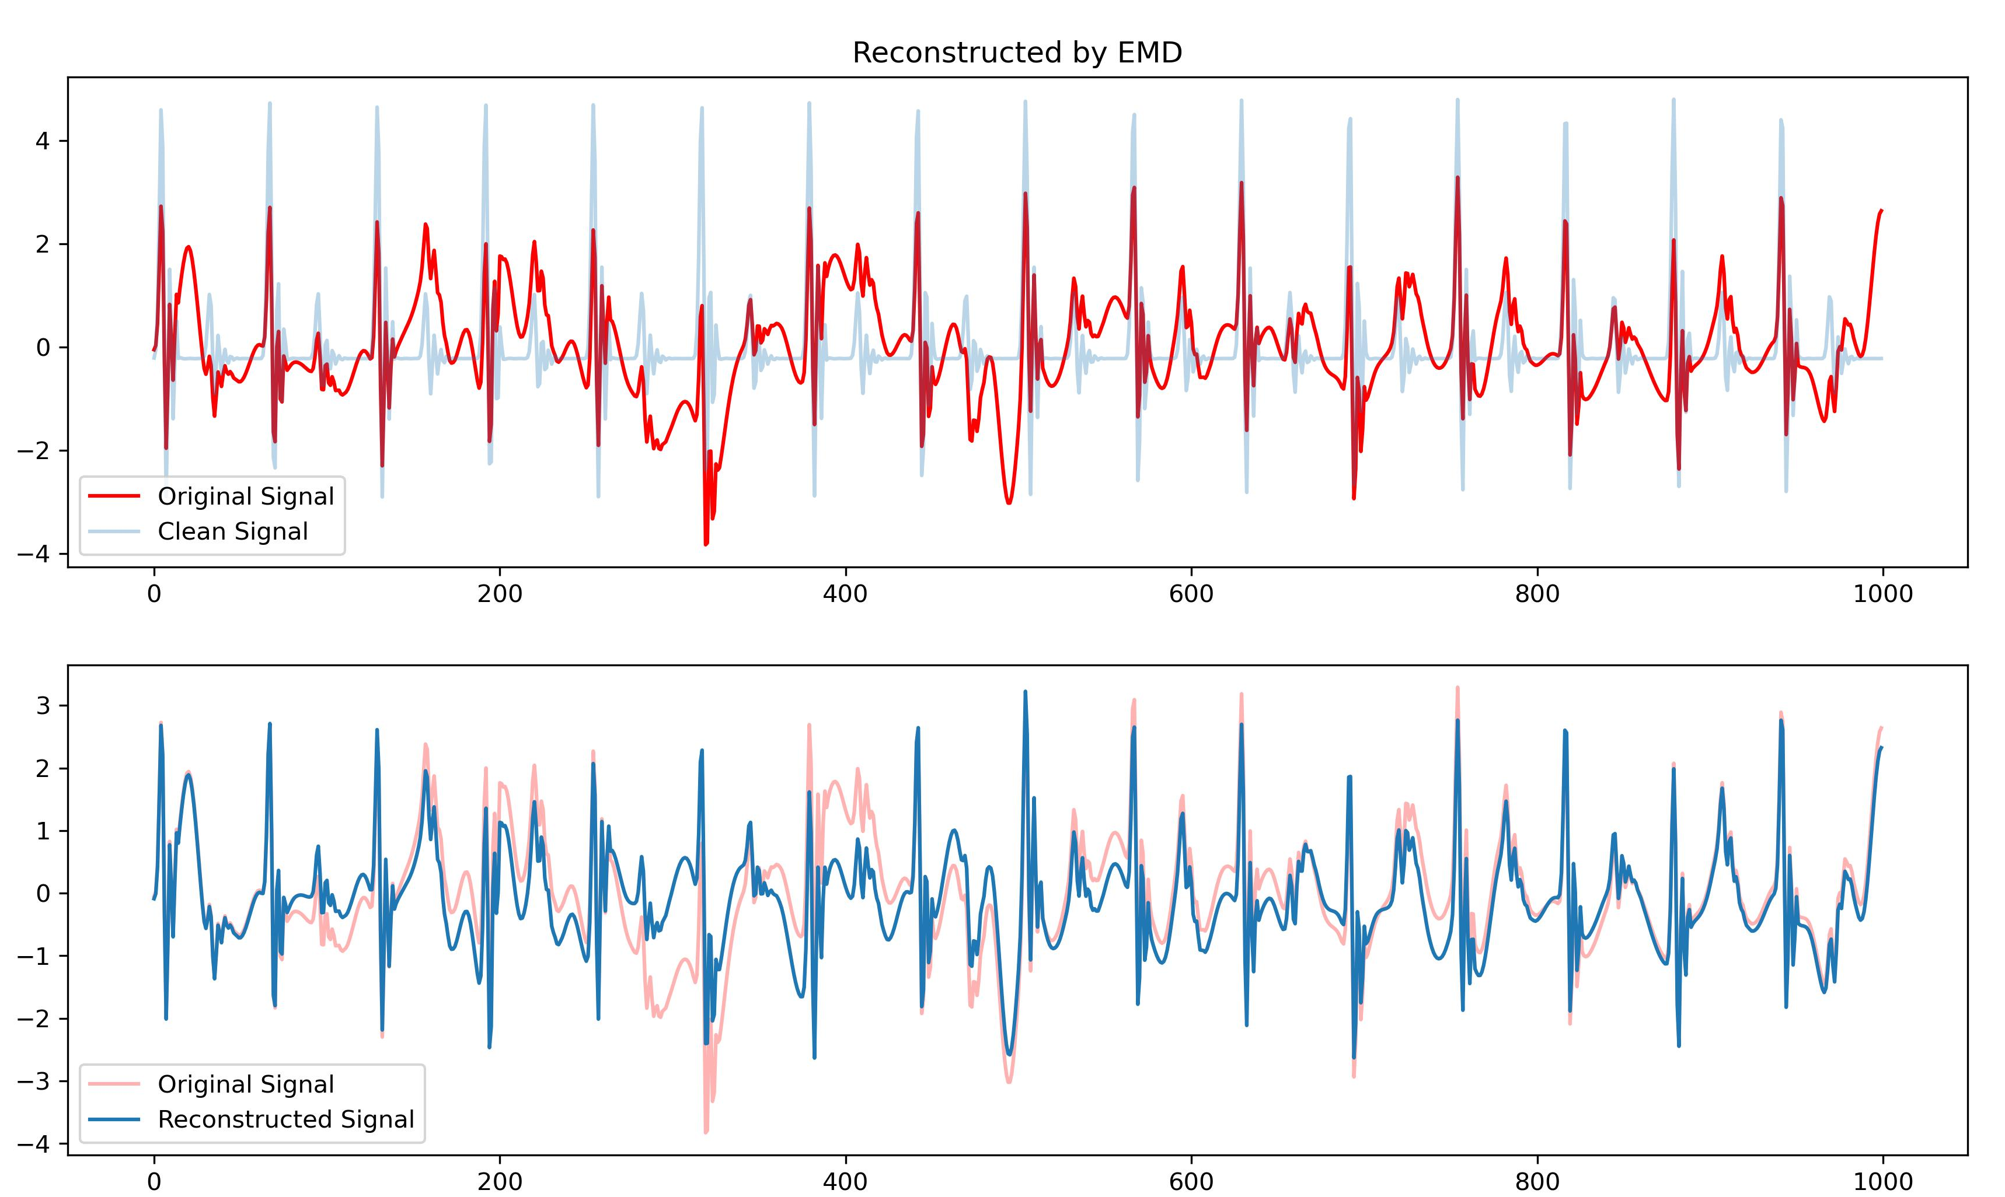
Work_1: S & D prediction in the noise level of 0.8
The decomposition effects of EMD
Reconstruction
Trend

Slide 9
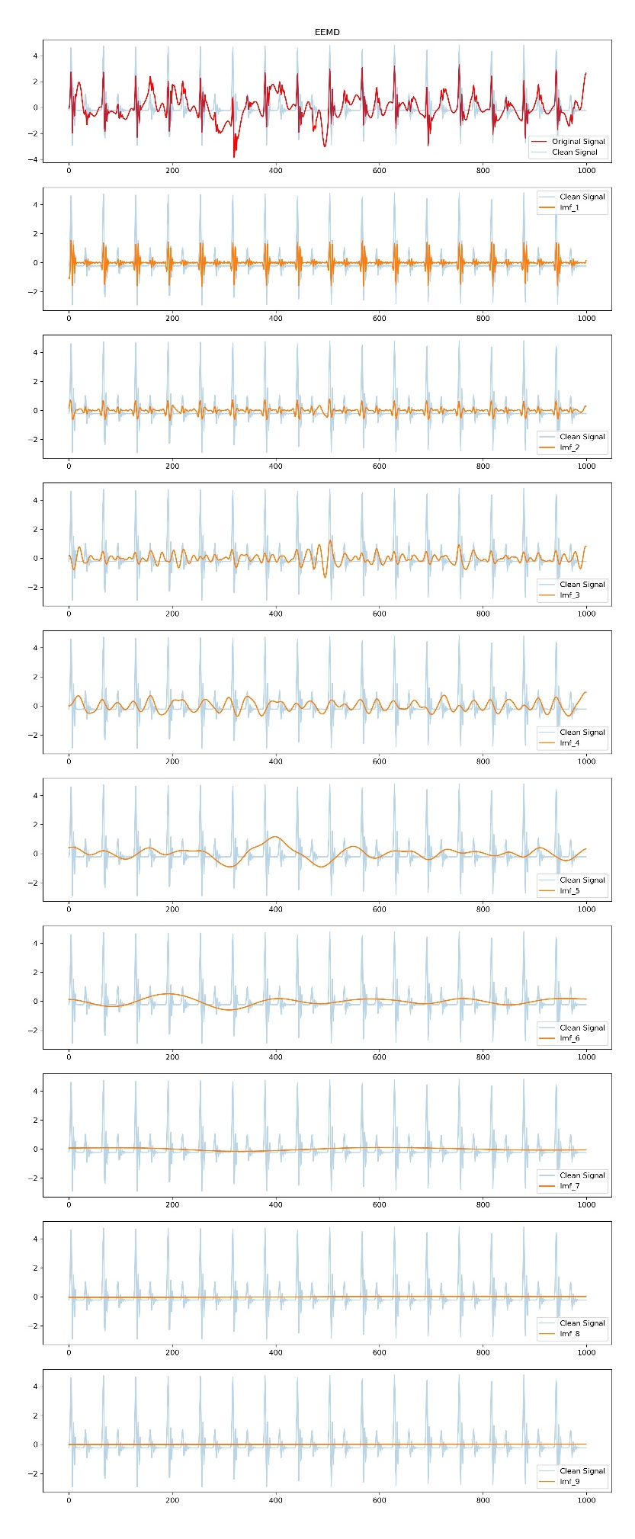
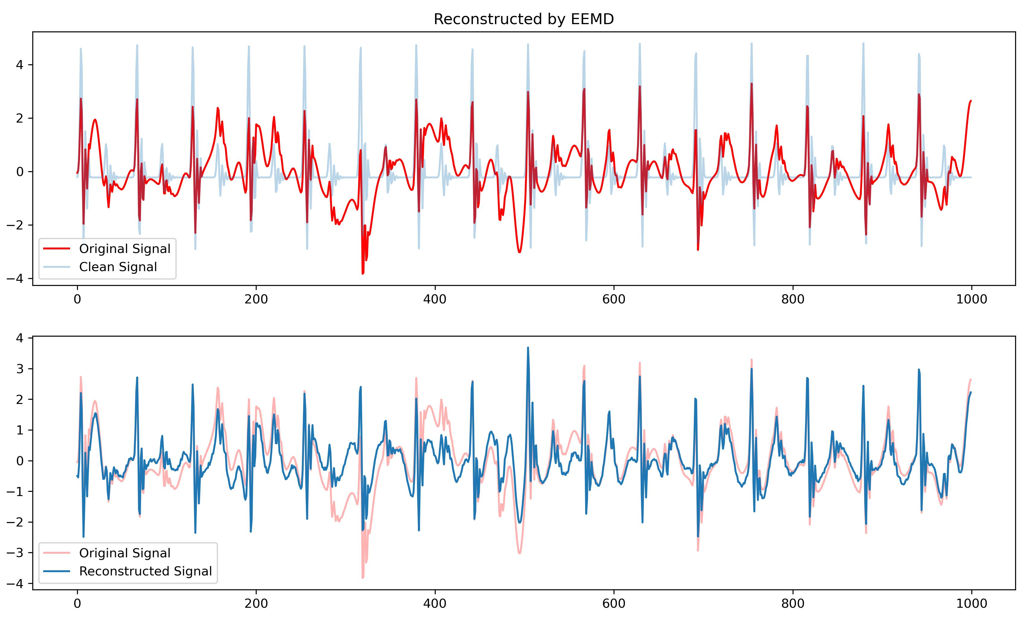
Work_1: S & D prediction in the noise level of 0.8
The decomposition effects of EEMD
Reconstruction
Trend

Slide 10
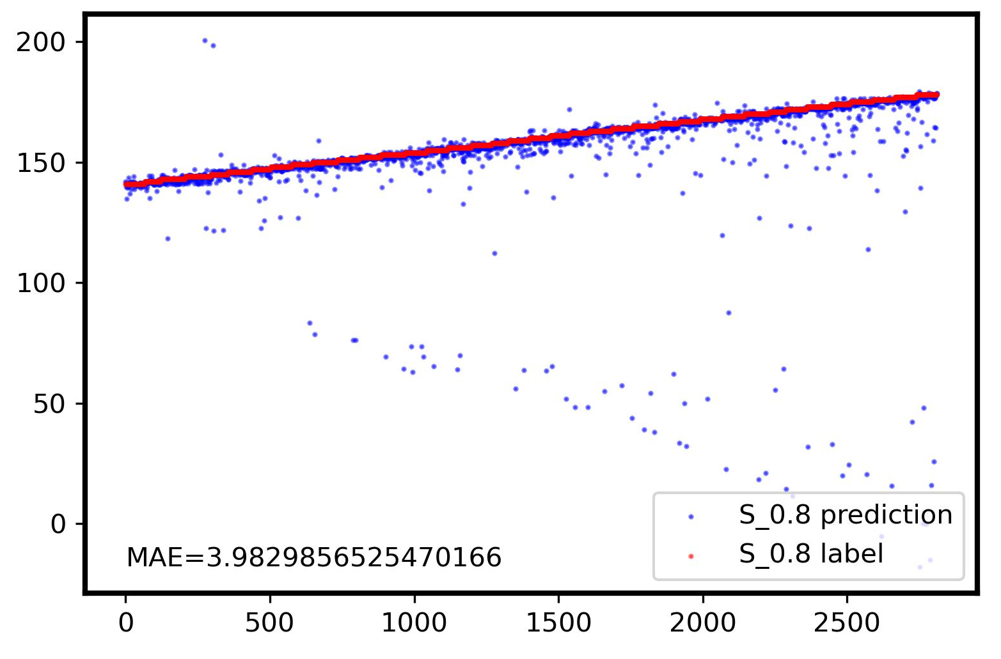
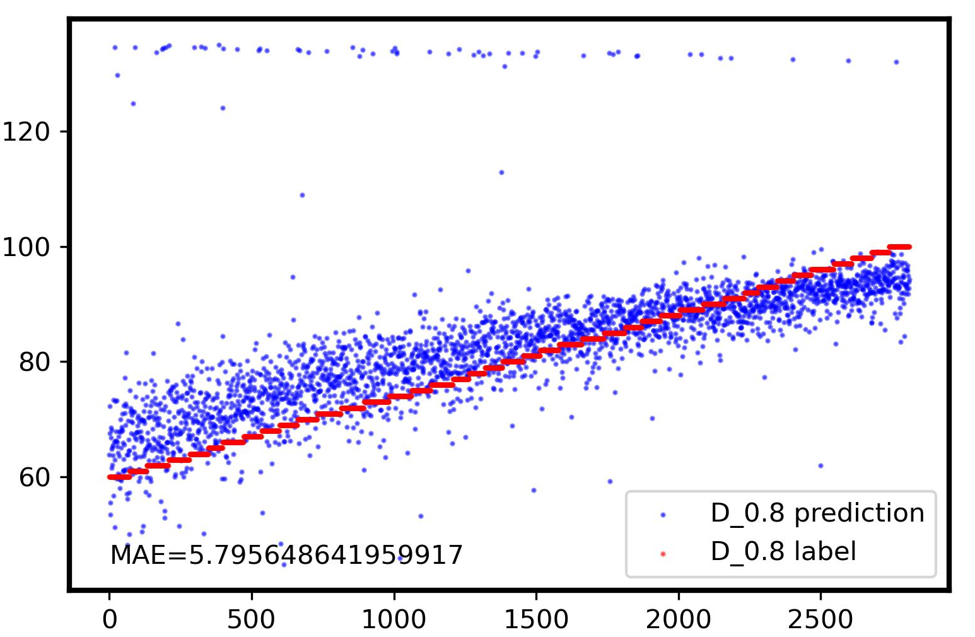
Work_1: S & D prediction in the noise level of 0.8
I believe this method has the potential to achieve MAE < 3 for the prediction of S and D, in the noise at the 0.8 level.
Further optimization lies in achieving higher precision in grouping, rather than relying on manual assessment of w-correlation matrices.
Surprisingly, the high predictive accuracy for D using this method is intriguing, as it suggests that the relative amplitude differences can be effectively restored. I plan to delve into the specific mathematical principles to gain a clearer understanding next week.

Slide 11
Work_2: S & D prediction in the noise level of 0.1 by getting template
Data
(Noise: 0.1, No RR)
Data
(Noise: 0.1, No RR)
Calculate period based on HR
Calculate Period based on peaks detection
此处插入计算公式
Segmentation
Segmentation
K-shapes Clustering
K-shapes Clustering
Get Template
Get Template
…
…
Notes:
第二个工作，我继续尝试了使用template进行预测in the noise level of 0.1
我们希望使用HR这个数字进行周期划分。但发现使用这种划分方法，会带来一些问题
我实际使用的，是基于peaksdetection后然进行周期计算的方法来进行划分。计算公式如右边所示。

Slide 12
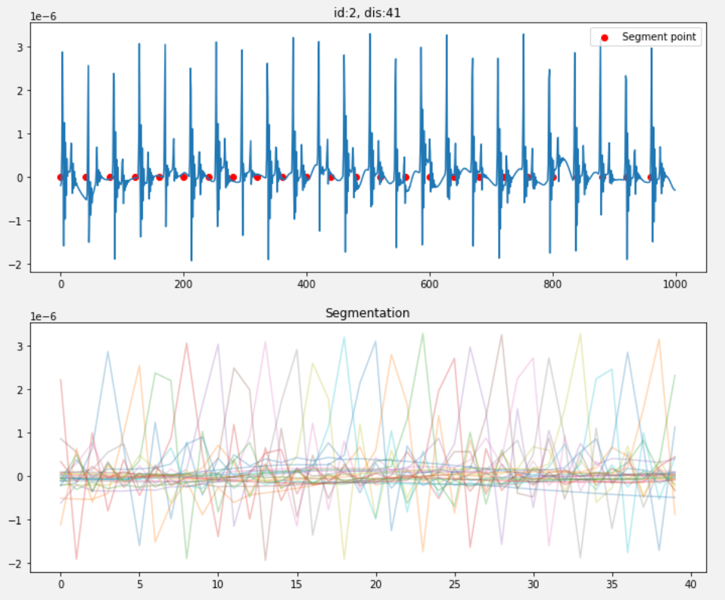
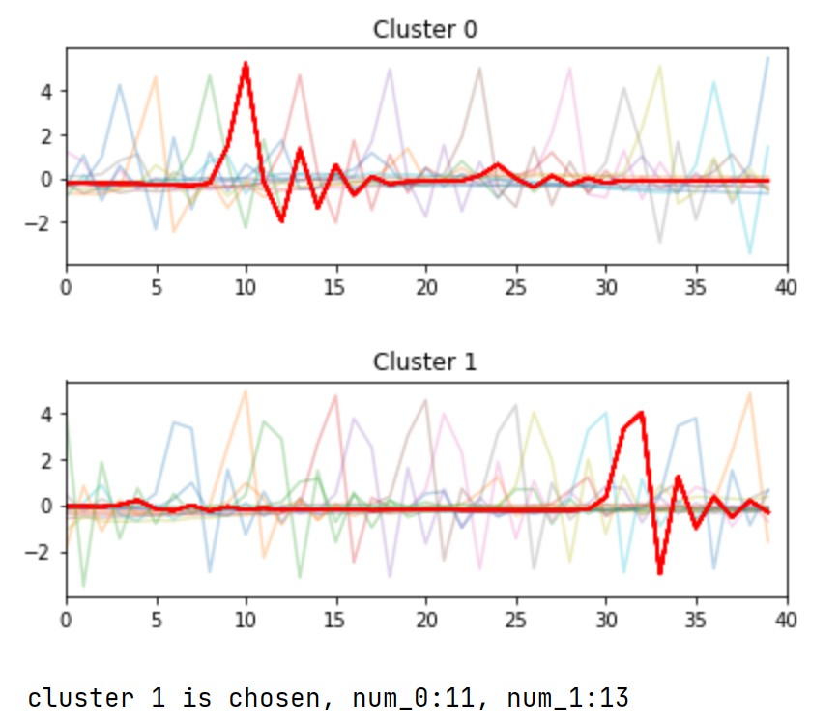
Work_2: S & D prediction in the noise level of 0.1 by getting template
基于HR的周期分隔，会出现很严重的参差现象。
每分钟的HR，并不等于这十秒的HR，一点点的误差周期，就会导致效果很差
同时Kshapes分成两类并且每一类的数量相近，
说明kshapes并没有生效
Notes:
使用HR进行分隔，会出现很严重的参差现象。
原因在于一分钟的HR数值，与十秒钟内的实际心跳数并不完全相等。一点点的误差周期，就会导致效果很差
此时，kshapes clustering也出现了较大的问题，选中了cluster_1, 它的小峰在大峰左边了。

Slide 13
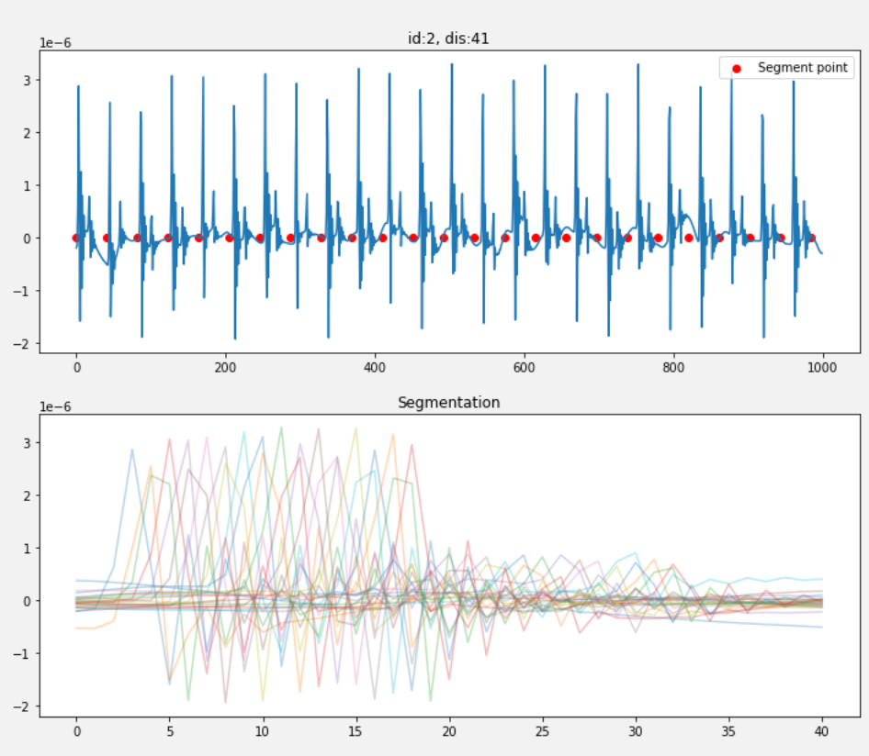
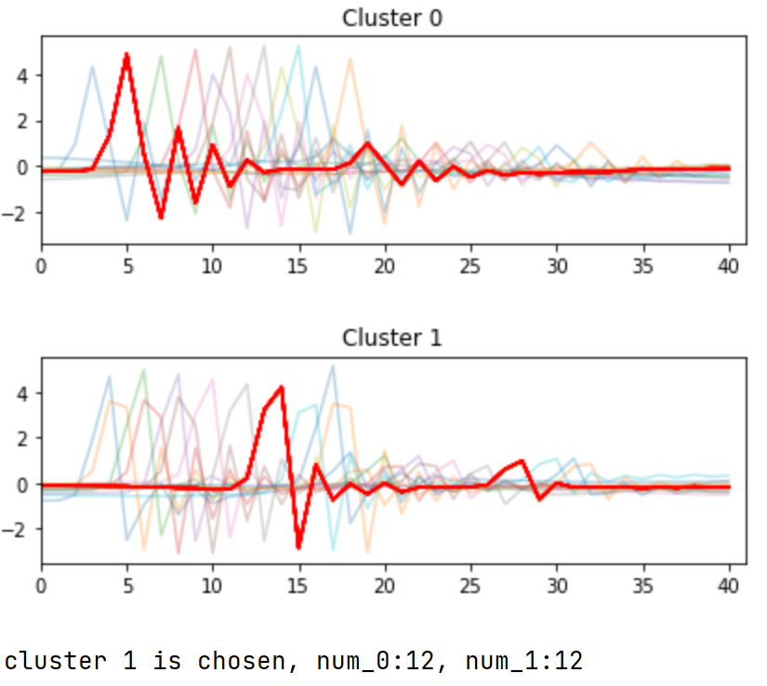
Work_2: S & D prediction in the noise level of 0.1 by getting template
基于峰数量的周期分隔，效果比基于HR的好很多，但依然不是很理想
Notes:
针对与同一信号，
基于峰数量的周期分隔，效果比基于HR的好很多。它的参差已经好了很多很多了，但是依然不够令人满意。

Slide 14
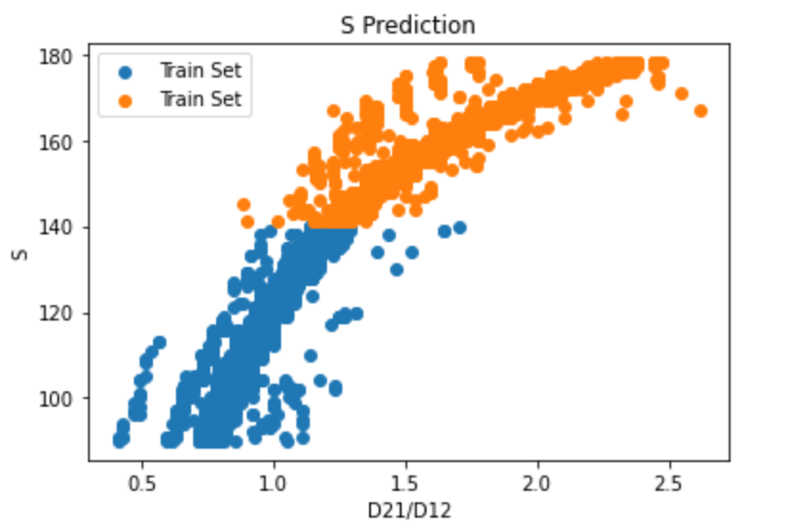
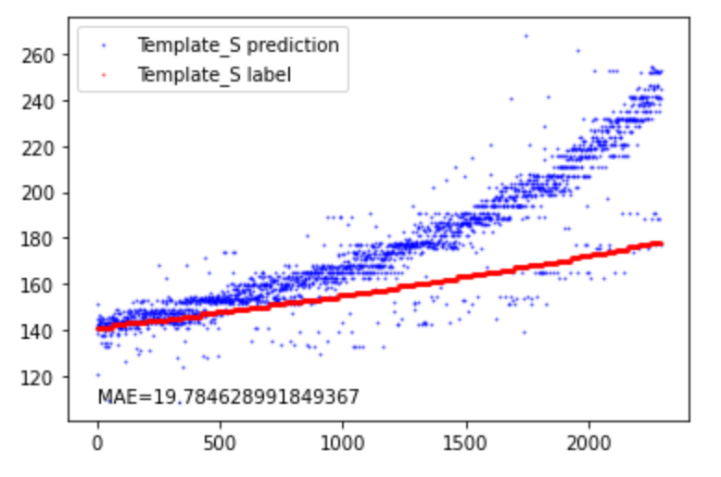
Work_2: S & D prediction in the noise level of 0.1 by getting template
Train Set
Test Set
奇怪之处在于：
训练集中， D21/D12和S的相关性达到了0.95
测试集中，D21/D12和S的相关性也达到了0.9+
特征提取应该非常完美的。
但是他们的各自线性回归的斜率，差距很大，致使Template_S的预测值往往偏大。
这一点的原因还没有搞清楚。

Slide 15
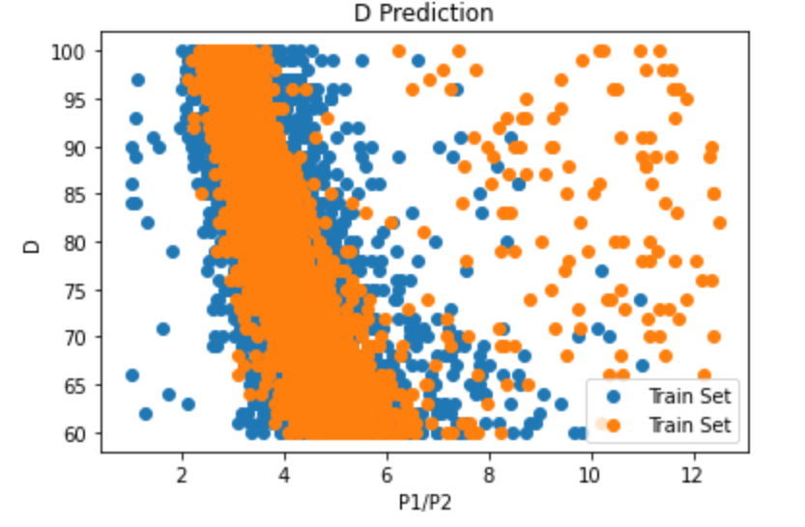
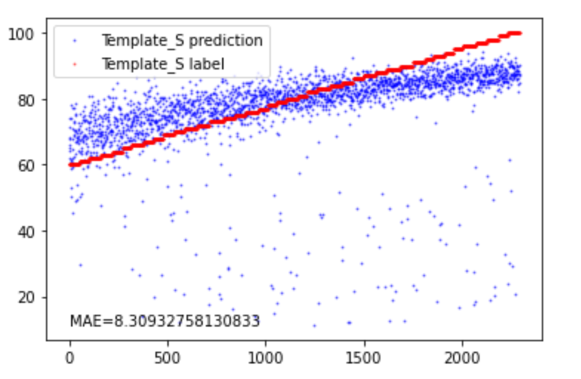
Work_2: S & D prediction in the noise level of 0.1 by getting template
Template_D prediction
Template_D label
对于D的预测，使用Template进行特征提取，离群点有点过多了。
我猜测是K-shapes带来的影响。
我下周会尝试去消除这种影响。

Slide 16
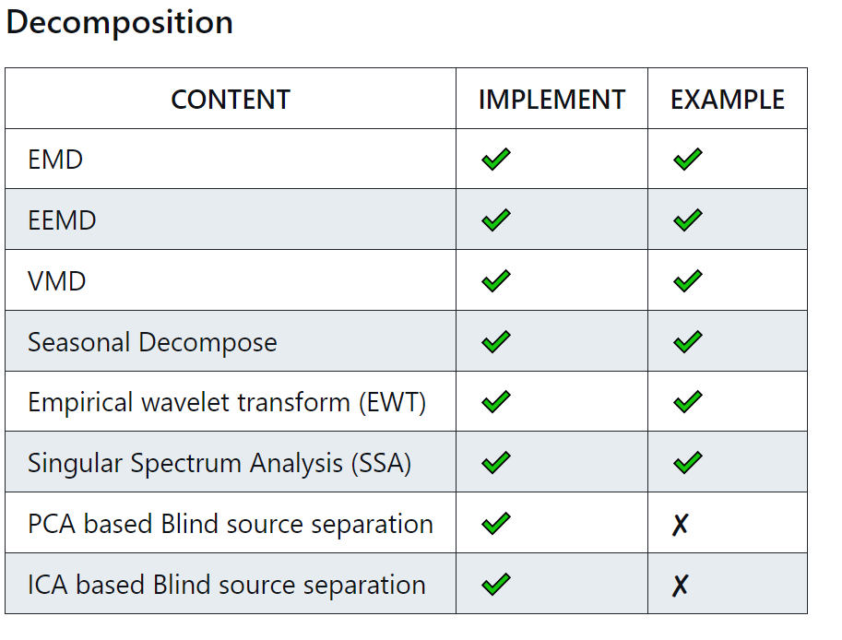
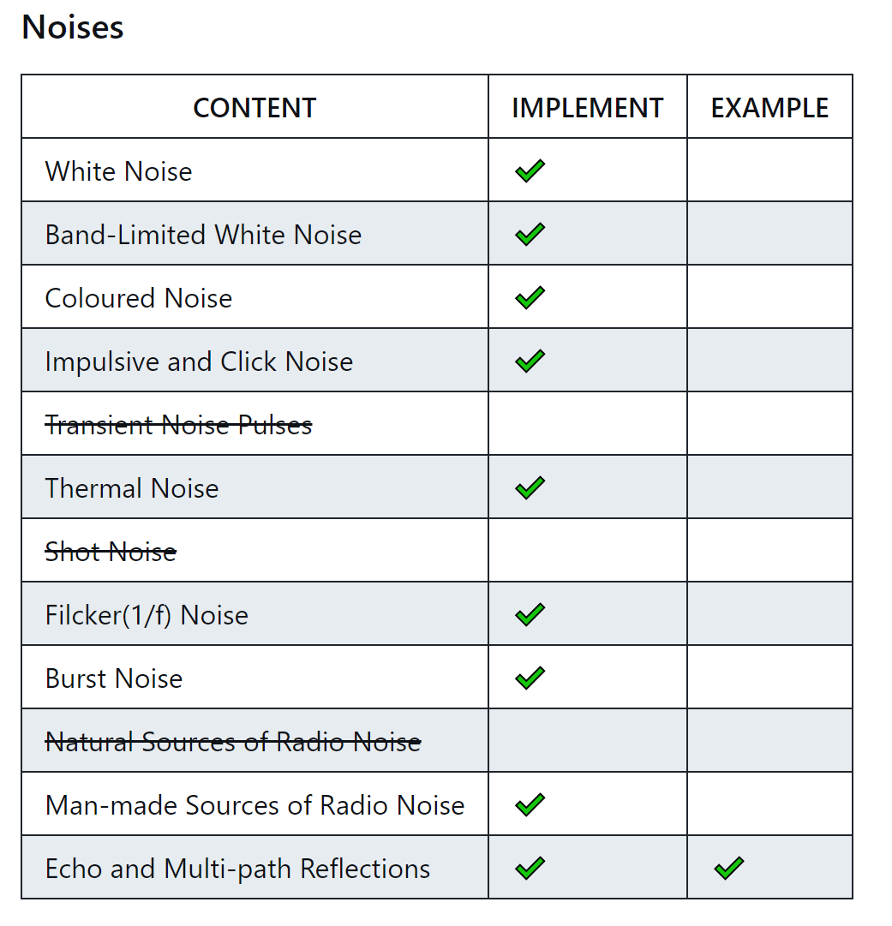
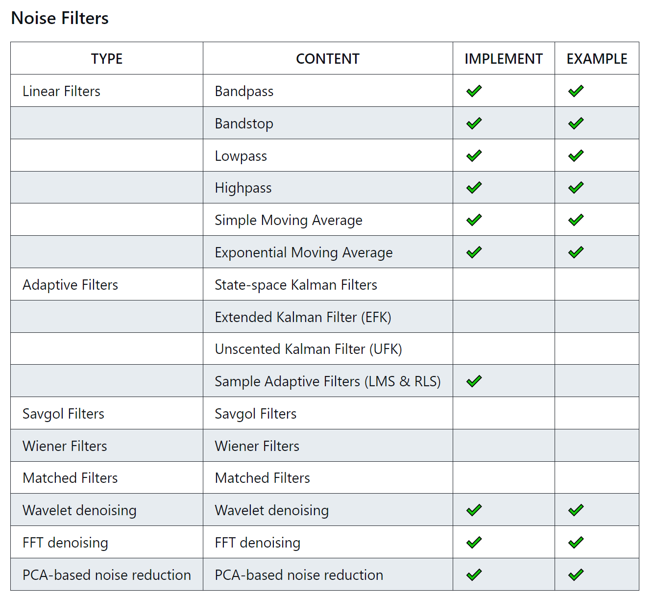
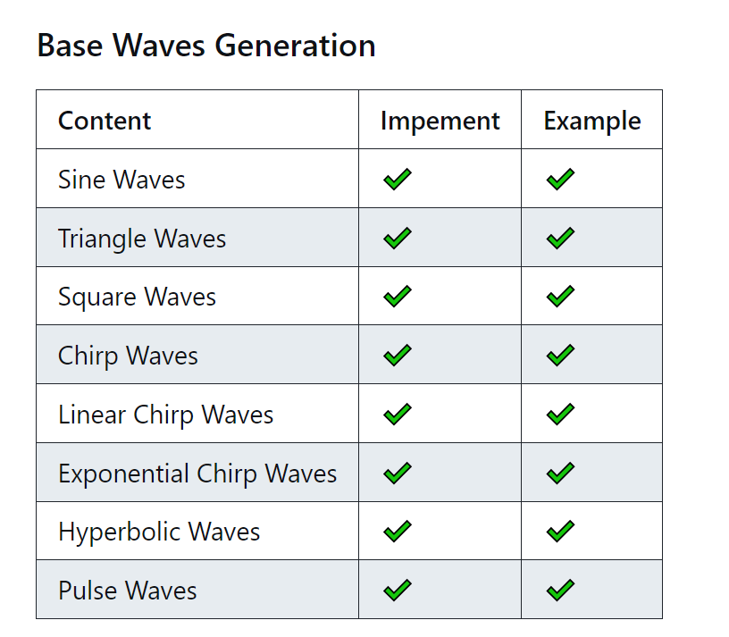
Work_3: Tutorial
Some advanced filters are not fully comprehensible at the moment. I will need to learn DSP and gradually work on implementing them.
Current SCG dataset doesn't provide a good example for algorithms, such as Blind Source Separation.
Notes:
关于Tutorial的书写，已近进入到了一个阶段了。
一些基础的内容，已经基本结束了
这一部分中最难的是advanced filter。Some advanced filters are not fully comprehensible at the moment. I will need to learn DSP and gradually work on implementing them.
目前也遇到一个问题：Current SCG dataset doesn't provide a good example for algorithms, such as Blind Source Separation.

Slide 17
Work_3: Tutorial
Notes:
我需要和你做一个确认。
目前我实现的，从算法封装，code comments，example，效果展示 这四个维度，是否满足你对这份Tutorial的需求。
如果不满足，我应该增加些什么

Slide 18
Work_4: Theoretical knowledge Learning
Signals and Systems
Probability for Computer Scientists
Course: EE120, Berkeley
This week’s Progress:
Review 10 Lectures
Finish 1 lab
Next week’s plan:
Lecture 10 (the DFT; FIR filters)
Lecture 11 (Fourier transforms in two dimensions)
Finish 1 lab
Course: CS109, Standford
This week's progress:
Part * 12
Next week’s plan:
Part * 12
Notes:
This week, I have a hard time learning Hidden Markov Models.
I need to allocate some time to learning probability in order to better understand advanced concepts.

Slide 19
Questions
The SCG dataset is no longer suitable for many tutorial algorithms, such as 对signals进行classification. Should we build some simple datasets ourselves, or could you provide us with a simulated dataset?
What’s that mean:It can be based on our SCG generator, and make it support different mother wavelets, such as Harr, Daubechies, Biorthogonal, Symlet, Meyer and Coiflets. I know the Nk2’s SCG simulation is based on Daubechies, should we use Harr or Symlet to simulate SCG?

Slide 20
Thanks!

